Slide 1
Distance Matters?
Notes:
See this as motivation?

Slide 2
References
See Distance Matters paper on GitHub by Olson & Olson
Working together aparthttp://interactions.acm.org/archive/view/march-april-2014/how-to-make-distance-work-work
J. Olson talk: https://www.youtube.com/watch?v=GlHd5GsXpJ8

Slide 3
Do you agree?
“Geography, borders, time zones – all are rapidly becoming irrelevant to the way we conduct our business and personal lives…” The Death of Distance, Cairncross 1997
(as referenced by Olson and Olson)

Slide 4
Why distance still matters?
Physical context
Language, body language
Time zones
Culture
Tacit knowledge

Slide 5
Characteristics of collocated work
Rapid feedback
Multiple channels
Personal information
Nuanced information
Shared local context
Informal “hall” time before and after
Coreference (deictic references)
Individual control
Implicit cues
Spatiality of reference

Slide 6
Remote work/learning examples…
Corporate sites
Scientific collaboratories
Moocs
Globally distributed open source projects

Slide 7
Common Ground
Knowledge that participants have in common, and they are aware that they have it in common
Participants need to mutually establish what they know or understand
Lack of common ground, misinterpretations require much time to repair
People who have good shared common ground, can deal with poor media
Notes:
And see Clark for a discussion on Common Ground

Slide 8
Media richness matters
Copresence – same physical environment/artifact access
Visibility to each other
Audibility (speech)
Contemporality (message received immediately)
Simultaneity – both speakers can send/receive
Sequentiality – turns cannot get out of sequence
Reviewability – able to review each other’s messages
Revisability – can revise messages before they are seen

Slide 9
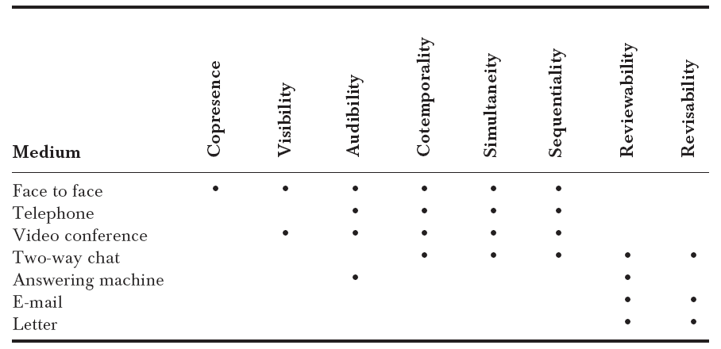
Factors for Establishing & Maintaining Common Ground
In the studies (and thus settings) described in this paper:
Notes:
So this may vary today!

Slide 10
Work coupling
The extent and kind of communication required by the work
How the work can be decomposed (number of dependencies)
Tightly coupled work, forming teams is hard to do remotely, so better to do that collocated

Slide 11
Collaboration Readiness
Rewarded for working together?
Willingness to share?
Culture of sharing should be in place first
Notes:
Consider the blogs… versus projects. How to change that perhaps?

Slide 12
Technology readiness
Need skills/resources before using the technologies
Need willingness to explore new technologies

Slide 13
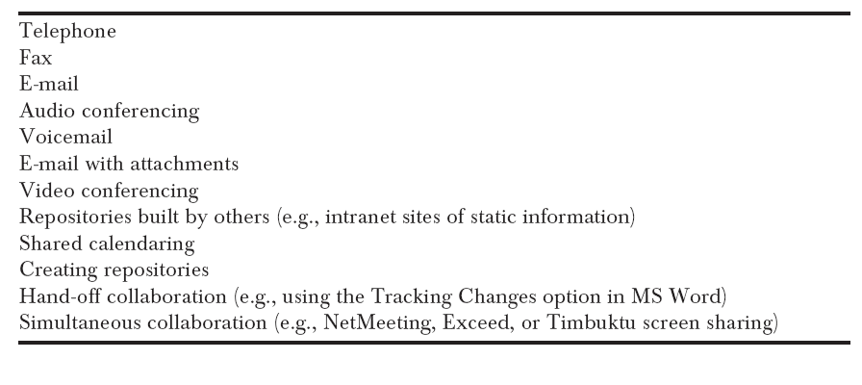
Technology readiness order
Again this is from a study in 2000! How would this look today?

Slide 14
What matters about distance
Blind and invisible
Time zone differences
Crossing institutional and cultural boundaries
Trust
Notes:
“out of sight out of mind”

Slide 15
Classes of tools
*** Communication Covenant ***
Communication tools
Coordination tools
Information repositories
Computational Infrastructure

Slide 16
Factors to consider
Cost
Speed of a response
Security, privacy
Who can read/write
Ease of use/learning
Compatibility/integration with other tools
Context information provided
Richness of what is communicated

Slide 17
Future?
Will remote ever be as good or better than face-to-face?
Issues of trust the same or different?
Time zones?
Culture? Power distance.
Notes:
Lunch in Quebec.
Europe/Asia, workers respect authority.
US – need to have buy in
Hamburger style of management.
Sweet talk, criticism (meat), encouragement.
Germans just meat
Japanese, just bun, have to smell the meat.
My most interesting experience – japanese at the WHO.

